Slide 1
Network Intrusion Detection
출처 : University of Idaho CS 404/CS 504

Slide 2
Network Intrusion Detection
Network Intrusion Detection
Network security is critical to every organization, as all computer systems suffer from security vulnerabilities
Network security requires solutions in place for protection from the increasing number of cyber threats
It is essential for every organization to implement some form of intrusion detection systems (IDS) that can discover potential threat events early and in a reliable manner
An intrusion is a deliberate unauthorized attempt, successful or not, to break into, access, manipulate, or misuse some valuable property, which may result into or render the property unreliable or unusable
An intrusion detection system (IDS) is a security tool for detecting unauthorized intrusions into computer systems and networks
A security system used to secure networks from unauthorized intrusions is a network intrusion detection system (NIDS)
NIDS should prevents possible intrusions by continuously monitoring the network traffic, to detect any suspicious behavior that violates the security policies and compromises the network confidentiality, integrity, and availability
Ahmad (2020) – Network Intrusion Detection System: A Systematic Study of ML and DL Approaches

Slide 3
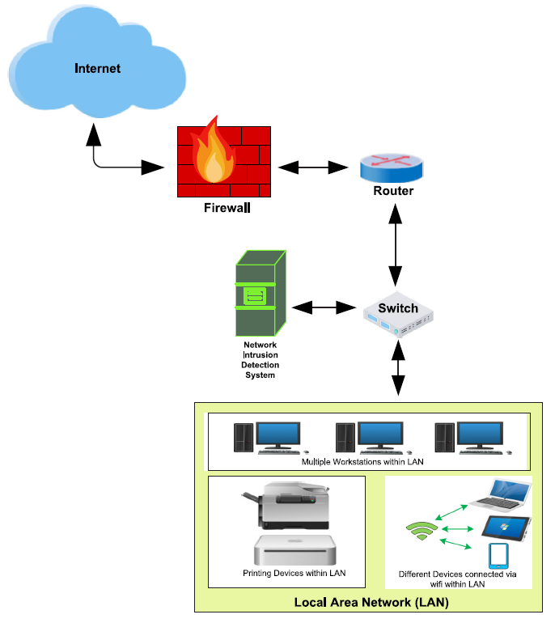
Network Intrusion Detection
Network Intrusion Detection
NIDS is implemented in the form of a device or software that monitors all traffic passing through a strategic point in the network for malicious activities
It is typically deployed at a single point, for example, it can be connected to the network switch (as in the figure)
If malicious behavior is detected, NIDS will generate alerts to the host or network administrators
Figure from: Ahmad (2020) – Network Intrusion Detection System: A Systematic Study of ML and DL Approaches

Slide 4
Goals of NIDS
Goals of Network Intrusion Detection Systems
The main goals of NIDS include:
Detect wide variety of intrusions
Previously known and unknown attacks
Suggests if there is a need to learn/adapt to new attacks or change in behavior
Detect intrusions in timely fashion
And minimize the time spent verifying attacks
Depending on the system criticality, it may be required to operate in real-time, especially when the system responds to (and not only monitors) intrusions
Problem: analyzing commands may impact the response time of the system
Present the analysis in a simple, easy-to-understand format
Ideally as a binary indicator (normal vs malicious activities)
Usually the analysis is more complex (than a binary output), and security analysts are required to examine suspected attacks
The user interface is critical, especially when monitoring large systems
Is accurate
Minimize false positives, false negatives
Slide credit: Intrusion Detection - Chapter 22 in “Introduction to Computer Security”

Slide 5
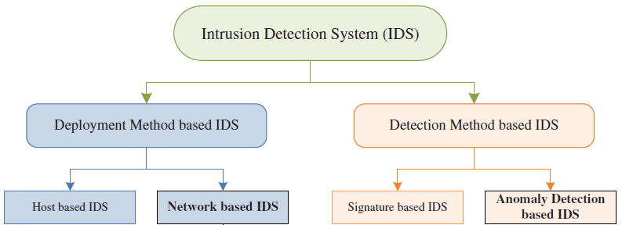
IDS Categories
IDS Categories
The figure depicts an IDS taxonomy based on the deployment or detection methods
Deployment methods
Host-based IDS – deployed to monitor the activities of a single host and scan for its security policy violations and suspicious activities
Requires information processing for each single node in a network
Network-based IDS – deployed to monitor the activities of all devices connected to a network
Figure from: Ahmad (2020) – Network Intrusion Detection System: A Systematic Study of ML and DL Approaches

Slide 6
IDS Categories
IDS Categories
Based on the used detection methods, IDS can be broadly divided into:
Signature-based systems
These systems are also known as misuse intrusion detection
The system compares the incoming traffic with a pre-existing database containing signatures of known attacks
Signature databases need to be continuously updated with the most recent attacks
Detecting new attacks, for which a signature does not exist, is difficult
Anomaly-based systems
The system uses statistics to form a baseline (normal) usage of the network at different time intervals
Deviations from the baseline usage are considered anomalies
The advantage is that these systems can detect unknown attacks
The main challenge is the high false alarms rate (as it is difficult to find the exact boundary between normal and abnormal behavior)
Cuelogic Technologies Blog - Evaluation of Machine Learning Algorithms for Intrusion Detection System

Slide 7
NIDS with Machine Learning
Network Intrusion Detection with Machine Learning
Enormous increase in network traffic in recent years and the resulting security threats are posing many challenges for detecting malicious network intrusions
To address these challenges, ML and DL-based NIDS have been implemented for detecting network intrusions
Anomaly detection has been the main focus of these methods, due to the potential for detecting new types of attacks
In the remainder of the lecture, we will first overview the datasets that are commonly used for training and evaluating ML-based NIDS, followed by a description of the ML models used for anomaly detection, and followed by adversarial attacks on ML models for NIDS

Slide 8
Datasets for Network Intrusion Detection
Datasets for Network Intrusion Detection
There are several public datasets consisting of records of normal network traffic and network attacks
Each record in these datasets represents a network connection data packet
The data packets are collected between defined starting and ending times, as data flows to and from a source machine and a target machine under a distinct network communication protocol
Network connection data packets are saved as PCAP (Packet Capture) files (i.e., .pcapfile)
PCAP files have different formats, e.g., Libpcap (Linux and macOS), WinPcap (Windows), and Npcap (Windows)
PCAP files are used for network analysis, monitoring network traffic, and managing security risks
The data packets allow to identify network problems
E.g., based on data usage of applications and devices
Or, identify where a piece of malware breached the network, by tracking the flow of malicious traffic and other malicious communications

Slide 9
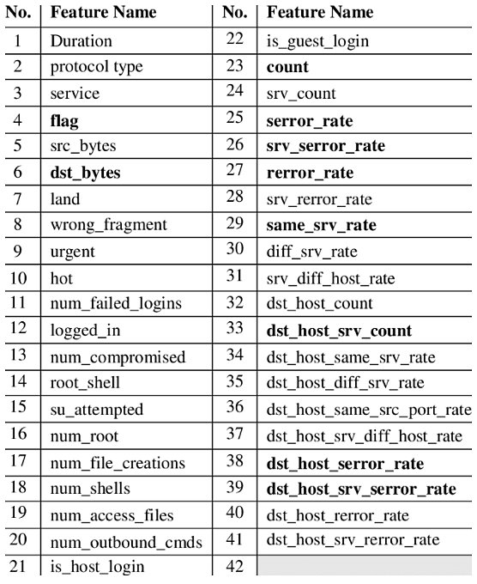
NSL-KDD Dataset
Datasets for Network Intrusion Detection
The most popular dataset for benchmarking ML models for NIDS has been the NSL-KDD dataset
It is an updated, cleaned-up version of the original KDD Cup’99 dataset (released in 1999 and containing many redundant files)
NSL-KDD contains 150 thousand network data packet records (PCAP files)
Each record has 41 features, shown in the table
The features include duration of the connection, protocol type, data bytes send from source to destination, number of failed logins, etc.
The 41 features are either categorical (4), binary (6), discrete (23), or continuous (10)
Many works use a selected subset of the 41 features
In addition, every record has a label (whether it is a normal traffic or attack) and a score (the severity of the traffic, on a scale from 0 to 21)
Table from: Gerry Saporito – A Deeper Dive into the NSL-KDD Data Set

Slide 10
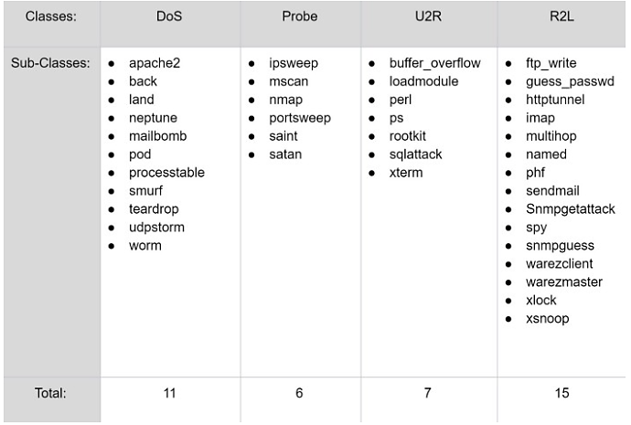
NSL-KDD Dataset
Datasets for Network Intrusion Detection
The attacks in the NSL-KDD dataset are categorized into 4 classes
DoS - Denial of Service, by flooding the server with abnormal amount of traffic
Probing - Surveillance and other probing attacks to get information from a network
U2R - Unauthorized access of a normal user as a super-user (gain access to the root)
R2L - Unauthorized access from a remote machine to gain local access
The subclasses for each attack are shown below, resulting in 39 attacks
Table from: Gerry Saporito – A Deeper Dive into the NSL-KDD Data Set

Slide 11
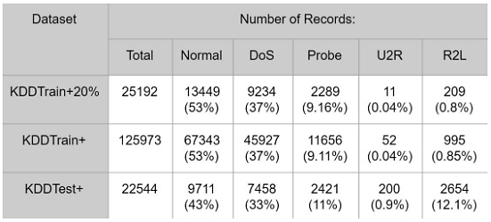
NSL-KDD Dataset
Datasets for Network Intrusion Detection
The records are divided into Train (125 K instances) and Test subsets (25 K instances)
As well as a smaller subset Train+20%, containing 20% of the train records (25 K)
The number of records per attack class is shown in the table
Majority of the records in the Train set are normal traffic (53%)
The most common attack in the Train set is DoS (37%), while U2R and R2L occur rarely
The Test set contains attack subclasses not seen in the Train set
Table from: Gerry Saporito – A Deeper Dive into the NSL-KDD Data Set

